Slide 1
Quantum-Tomography
Tomography Demo

Slide 2


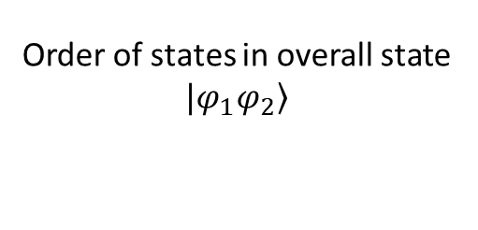
2 Qubits 4 Detectors
Order of states in overall state $\left.|φ_{1}φ_{2}\right\rangle$
3
First qubit $φ_{1}$
1
Second qubit $φ_{2}$
2
4
Some way to rotate the state before the beam splitter ex: Wave plates or LCVR
Beam splitter
Detector

Slide 3


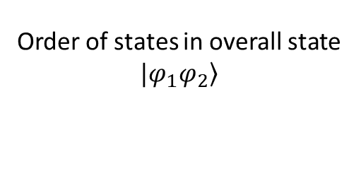
2 Qubits 4 Detectors OLD
Order of states in overall state $\left.|φ_{1}φ_{2}\right\rangle$
3
Det-pair 1 : 1-2
Det-pair 2 : 1-4
Det-pair 3 : 3-2
Det-pair 4 : 3-4
Efficiency setting in same order to compensate for some detectors being much better at detecting single photons.
[1,1,1,1]
First qubit $φ_{1}$
1
Second qubit $φ_{2}$
2
4
Some way to rotate the state before the beam splitter
Wave plates
LCVR

